Slide 1
CAPSTONE PROJECT
PGP-DSBA (Post Graduate Program in Data Science and Business Analytics)

Slide 2




AGENDA
Grade Policy and Certification
Domain Application
Capstone Project Sessions
Roadmap of Capstone Project

Slide 3
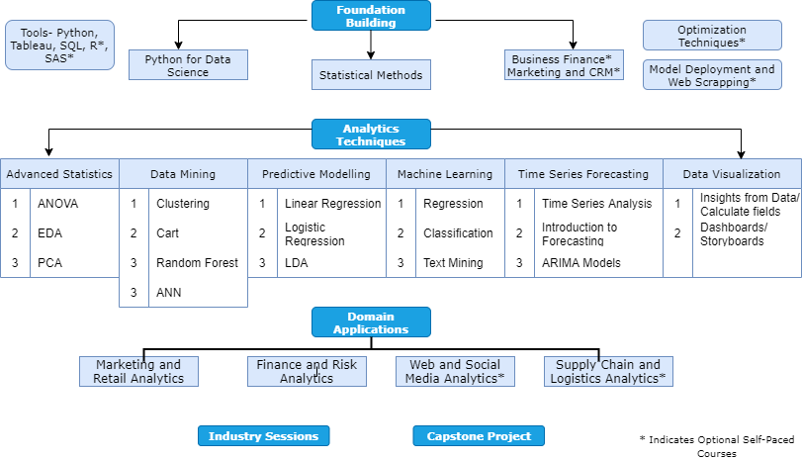
PROGRAM STRUCTURE

Slide 4


DOMAIN APPLICATION
GRADED COURSES
MARKETING AND RETAIL ANALYTICS (MRA)
FINANCE AND RISK ANALYTICS (FRA)
Course Duration-3 Weeks
Video Duration- 8 hours
Live Virtual Classes- 2
Self Study- 13 hours
Course Duration-3 Weeks
Video Duration- 8 hours
Live Virtual Classes- 2
Self Study- 13 hours

Slide 5
NON- GRADED COURSES
(SELF PACED)
WEB AND SOCIAL MEDIA ANALYTICS
(WSMA)
8 HOURS VIDEO DURATION
SUPPY CHAIN AND LOGISTICS ANALYTICS
(SCLA)
8 HOURS VIDEO DURATION

Slide 6



ONLINE SESSION- EXPECTATIONS
Learners are expected to come prepared for the Live Virtual Sessions
Weekly Videos
Watch all the videos of the week and be prepared to ask doubts, if any
Practice Assessments
Practice the given practice assessment to assess your understanding on the topic
Session Agenda
Download the files for weekend session and understand the agenda for the session
Practice is the key to success

Slide 7
FOCUS OF NEXT SIX WEEKS
9th October
Release of MRA Course
Release of Capstone Project
12th October
Program Manager to share Google form for Project Preference
30th October
Release of FRA Course
1st November
Submission of MRA Project
15th November
Submission of Capstone Project Preference
29th November
Submission of FRA Project

Slide 8

GRADE POLICY
The evaluation of academic performance in each course is based of following criteria
Total modules 11 (2 Foundations + 5 Core + 2 Tools + 2 Domains)
Each module evaluation is out of 100 marks
Minimum marks to complete a module is 60
Grading Pattern of Core Modules
Weekly Assessments- 10 * 3 = 30
Project- 60
Attendance for mentoring sessions- 10
Grading Pattern for Domain modules and DVT
Project- 90
Attendance for live virtual sessions- 10
Grading Pattern for SQL module
Quiz- 10
Project- 80
Attendance for live virtual sessions- 10
*Complete minimum 9 modules in order to be eligible for certification

Slide 9
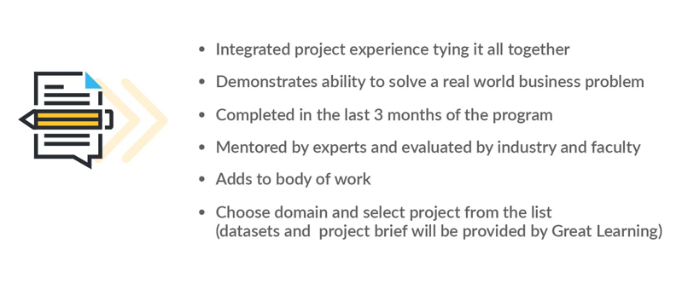
CAPSTONE PROJECT

Slide 10
CAPSTONE ROADMAP
Olympus Walkthrough

Slide 11
MENTOR CONNECT- EXPECTATIONS
Duration of Capstone Mentor Connect- One hour
Mentor will clarify your doubts based upon the agenda shared for the respective connects
Doubts and important points will be discussed in the session. Your capstone mentor is to guide you on the project problem solving, codes and completion should be attempted by Candidates to learn
For further doubts, feel free to write over the Program Support Query or connect with your Program Manager

Slide 12
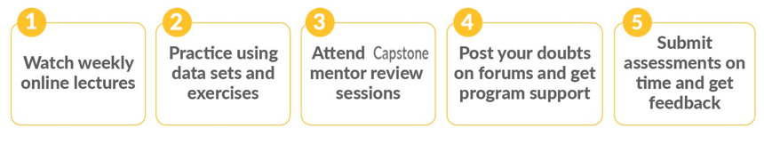
HOW TO MAKE MOST OF YOUR LEARNING EXPERIENCE

Slide 13
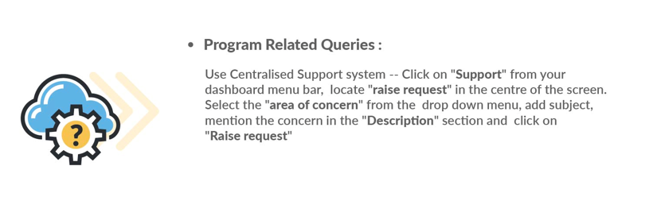
CONTACT US FOR SUPPORT

Slide 14
Thanks
Happy Learning ☺

